Slide 1

Convolutional Neural Network (CNN)

Slide 2
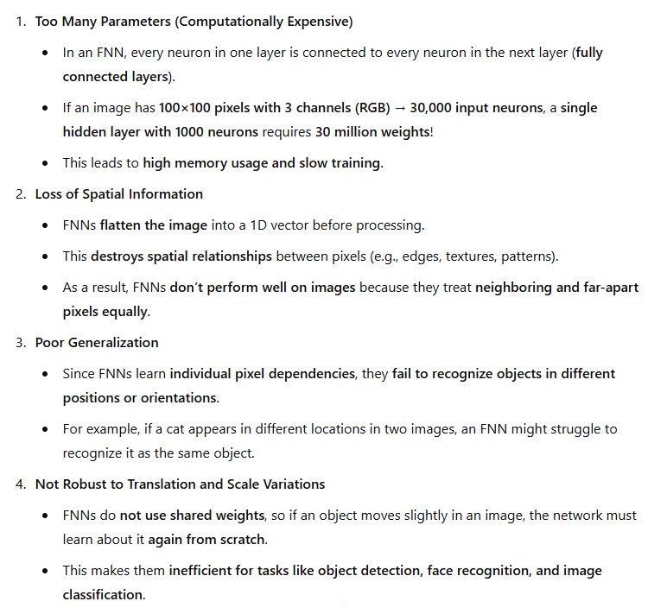
Limitations of Feedforward Neural Networks (FNNs) for Images

Slide 3
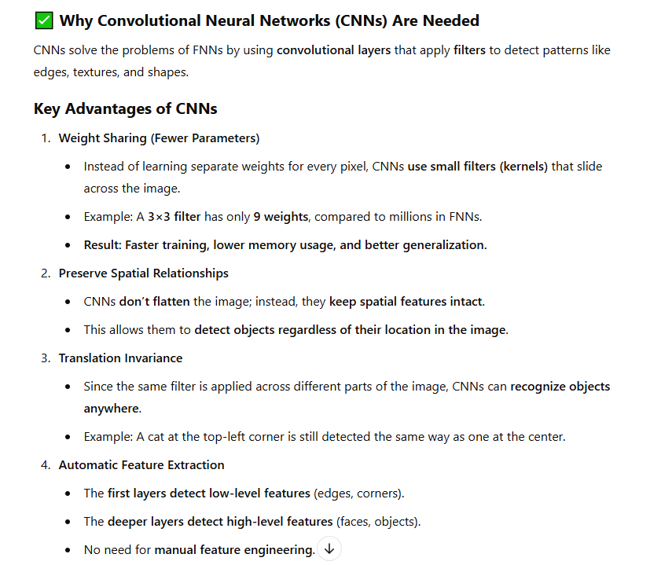

Slide 4
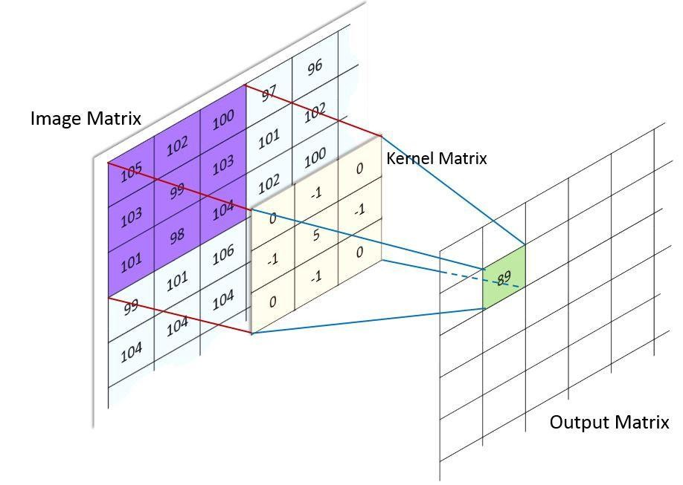
Convolution operation in images
Convolution is a mathematical way of combining two signals to form a third
signal.
Convolution is a simple mathematical operation which is fundamental to many common image processing operations.
Convolution is a mathematical way of combining two signals to form a third signal. Convolution provides a way of `multiplying together' two arrays of numbers, generally of different sizes, but of the same dimensionality, to produce a third array of numbers of the same dimensionality.

Slide 5
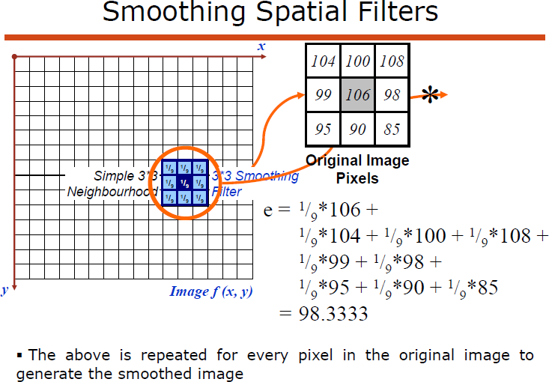

Slide 6
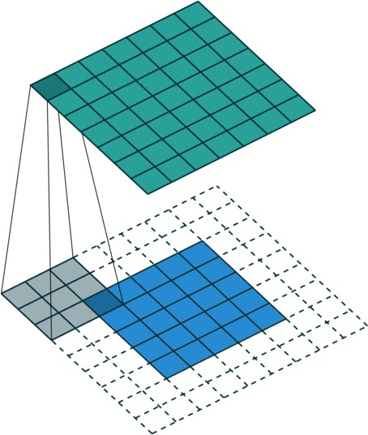
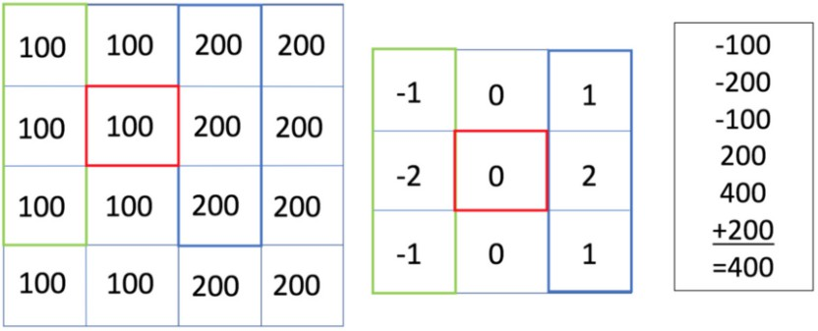
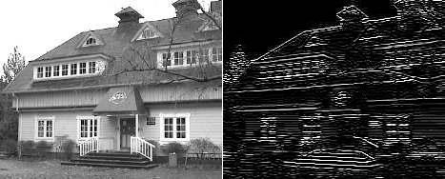
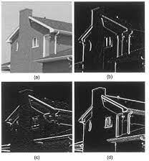
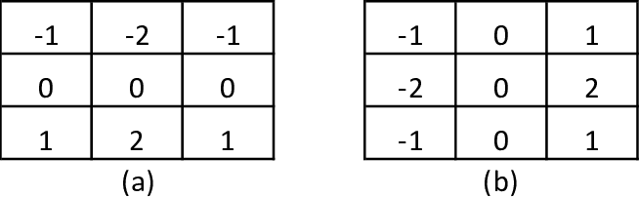
Convolution operation in images
Image
Kernel/Filter
Sobel Masks
(a) Horizontal edge Filter (b) Vertical edge Filter
Edge detection using sobel operator

Slide 7
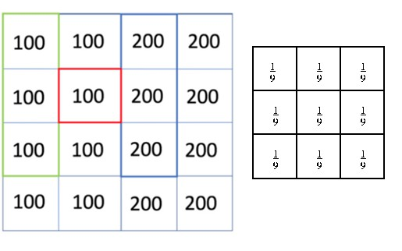
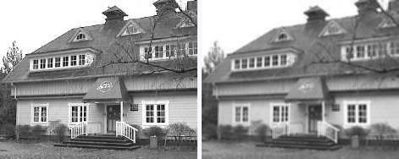
Convolution operation in images
Image
Kernel/Filter
Average Filter
Blurred image with average filter

Slide 8
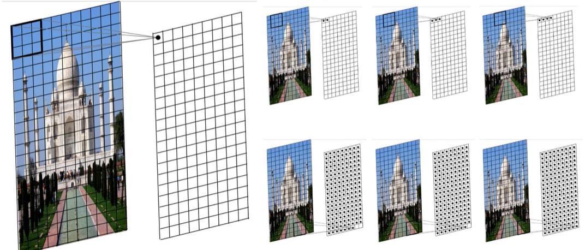
2D convolution

Slide 9
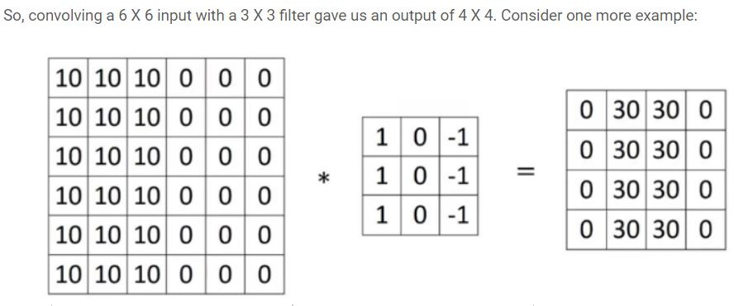




Convolution
Convolving an input of 6 X 6 dimension with a 3 X 3 filter results in 4 X 4 output.
Input: n X n
Filter size: f X f
Output: (n-f+1) X (n-f+1)

Slide 10
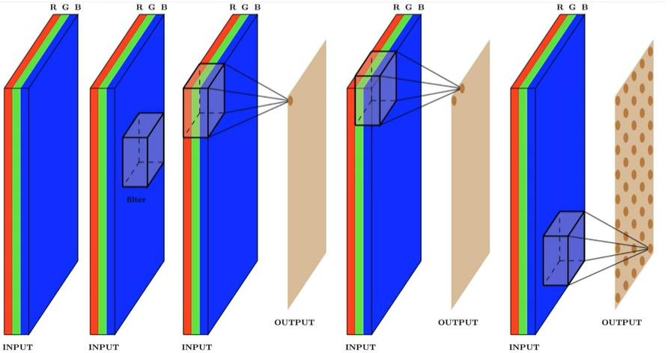
3D Convolution
Input 3D, Filter 3D, Output 2D

Slide 11
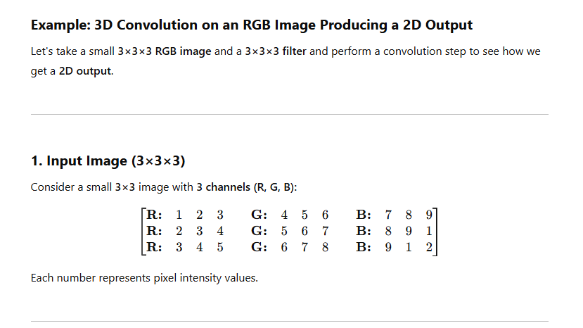
Numerical Example

Slide 12
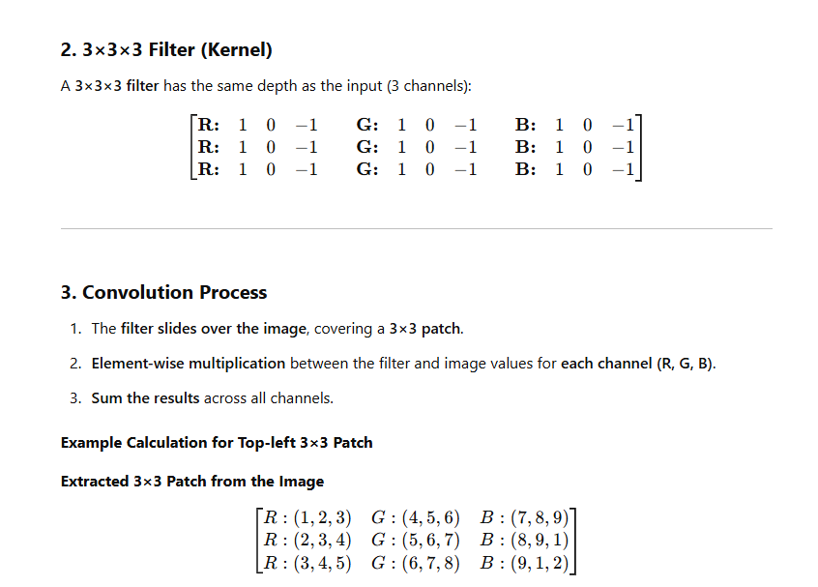

Slide 13
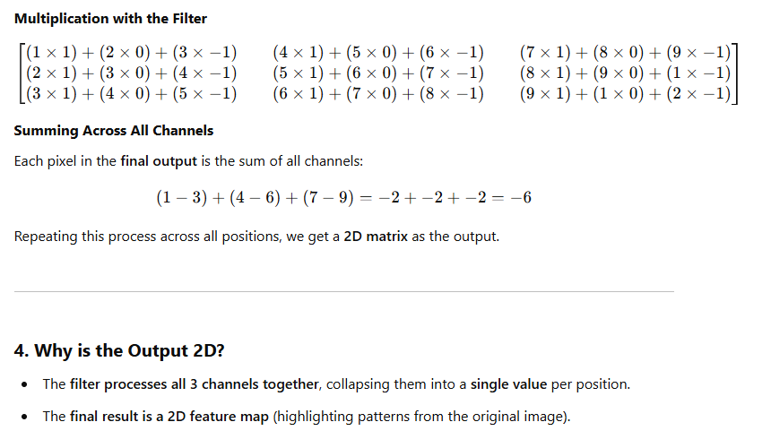

Slide 14
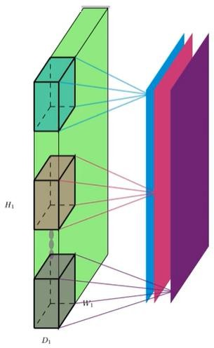
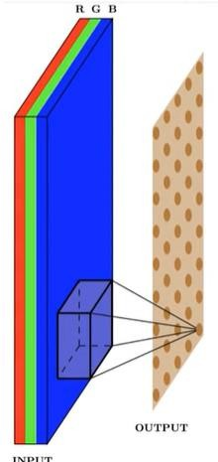
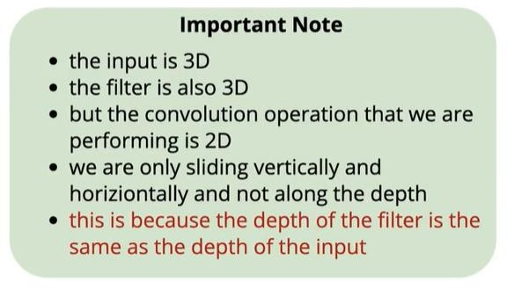
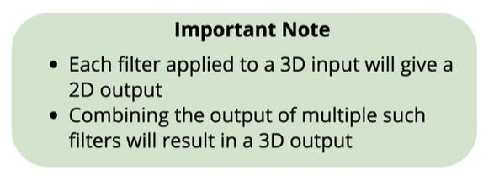
3D Convolution
Apply multiple 3D filters to the same image
3D convolution produce 2D output

Slide 15
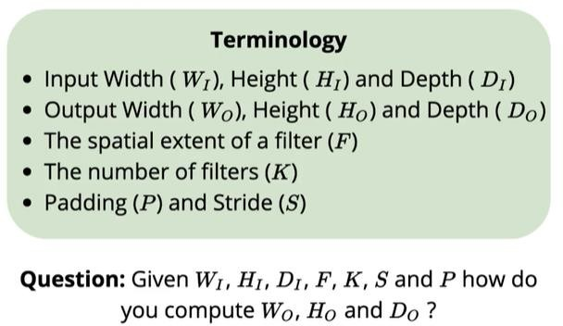
How to compute W0,H0,D0?

Slide 16
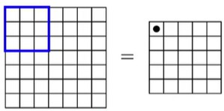
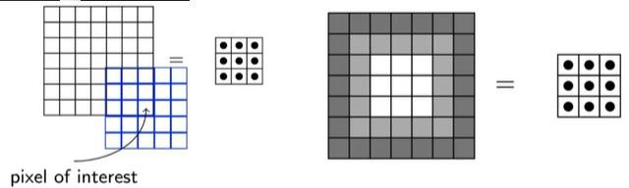
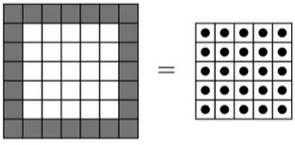
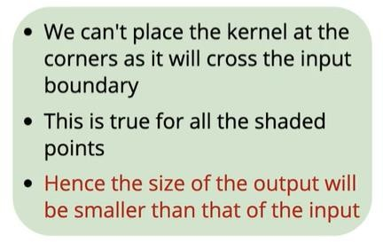
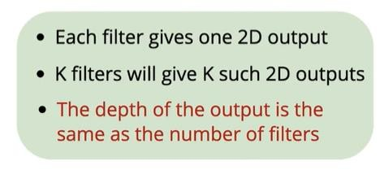
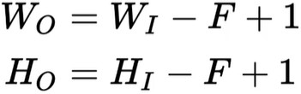
No padding- size of ouput reduce
7x7
7x7
5x5
7x7
3x3
Kernel 3x3
Kernel 5x5
7-5+1=3 hence 3x3
7-3+1=5 hence 5x5

Slide 17
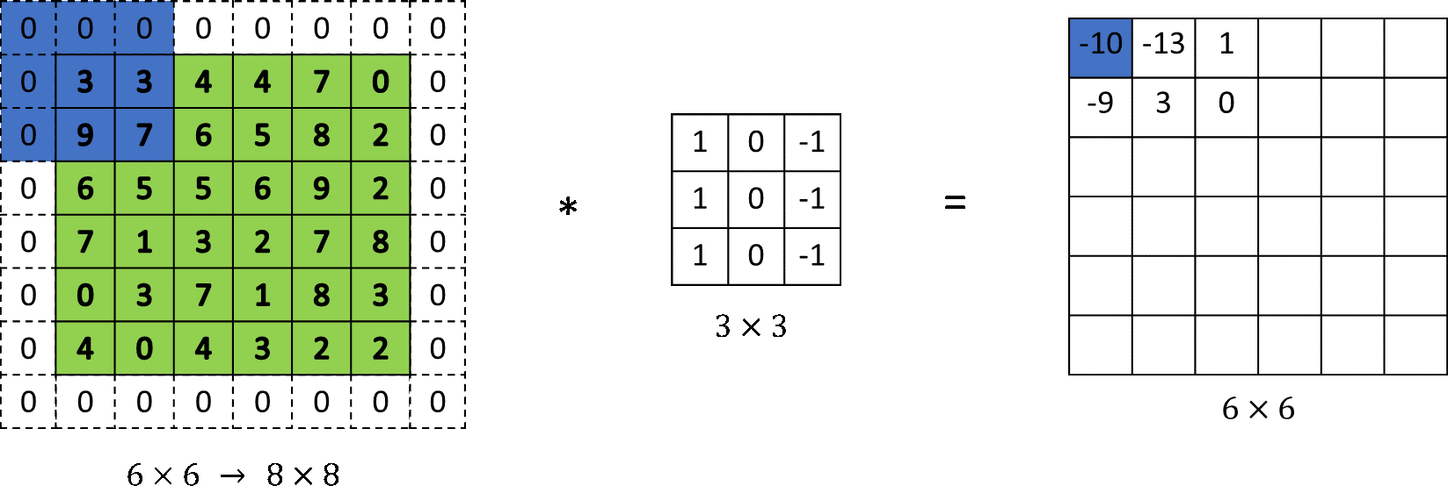
Padding
With padding
Input: n X n
Padding: p
Filter size: f X f
Output: (n+2p-f+1) X (n+2p-f+1)
Without padding
Input: n X n
Filter size: f X f
Output: (n-f+1) X (n-f+1)

Slide 18
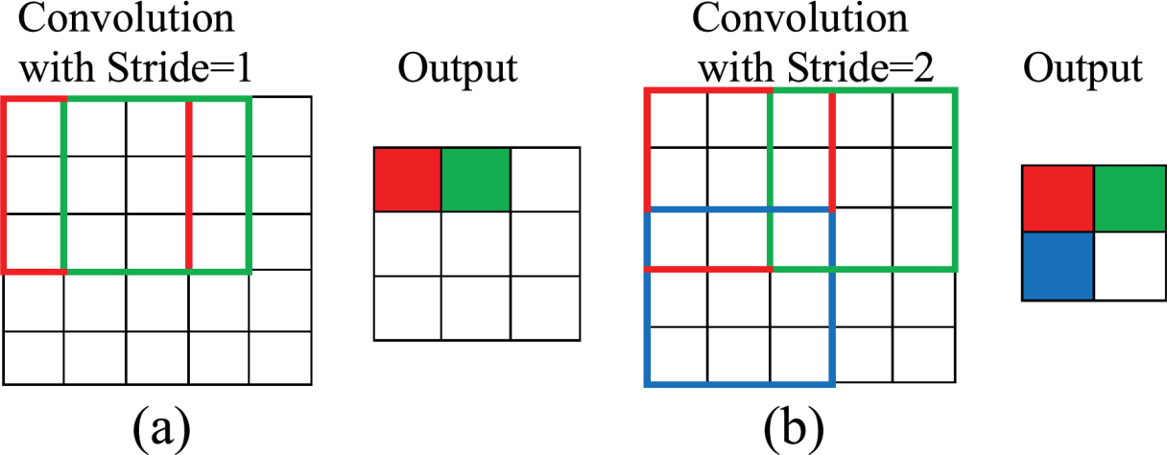
Strided Convolutions
Stride is a parameter of the neural network's filter that modifies the amount of movement over the image or video.
For example, if a neural network's stride is set to 1, the filter will move one pixel, or unit, at a time.
Suppose we choose a stride of 2. So, while convoluting through the image, we will take two steps – both in the horizontal and vertical directions separately. The dimensions for stride s will be:
Input: n X n
Padding: p
Stride: s
Filter size: f X f
Output: [(n+2p-f)/s+1] X [(n+2p-f)/s+1]
Stride helps to reduce the size of the image, a particularly useful feature.

Slide 19

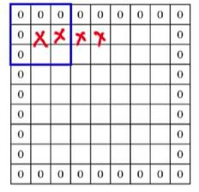
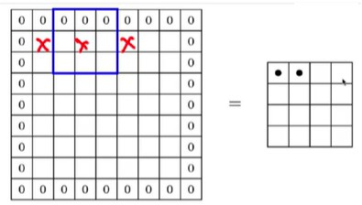
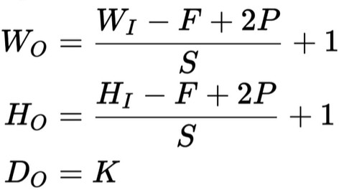
Stride and padding
Higher the Stride ,smaller the
size of the output
Wi=7, Hi=7 F=3
P=1 S=2
(𝟕−𝟑+𝟐)
Wo= Ho= 4
+1= 4
𝟐

Slide 20
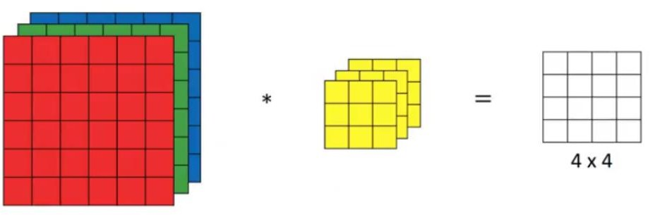
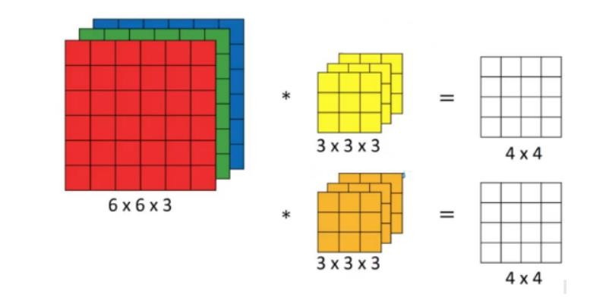
Convolutions Over Volume
Generalized dimensions can be given as:
Input: n X n X n_{c}
Filter: f X f X n_{c}
Padding: p
Stride: s
Output: [(n+2p-f)/s]+1 X [(n+2p-f)/s]+1 X n_{c}’
Here, n_{c} is the number of channels in the input and filter, while n_{c}’ is the number of filters.

Slide 21







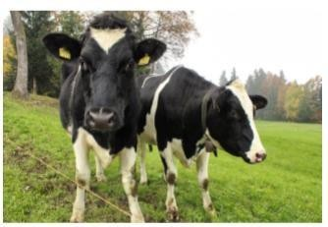
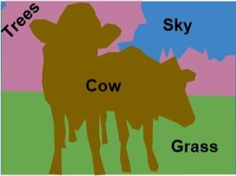



Recollect- Conventional methods
Image
Acquisition
Image
Enhancement
Image
Segmentation
Feature Extraction
Object Recognition/ Machine Learning

Slide 22
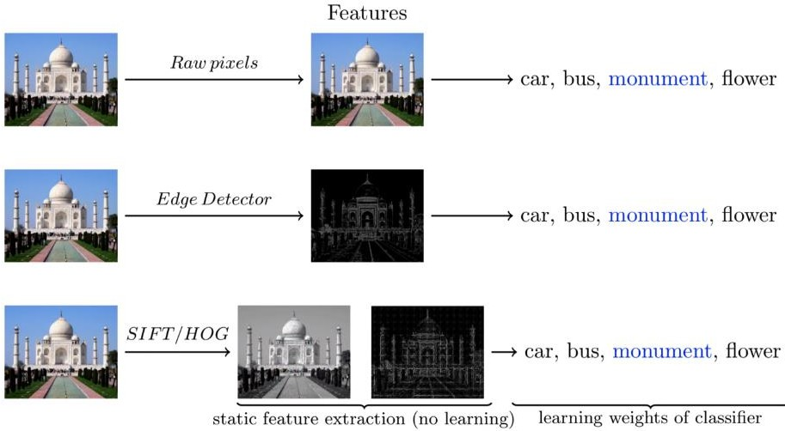
Feature Extraction ( Handcrafted features)

Slide 23
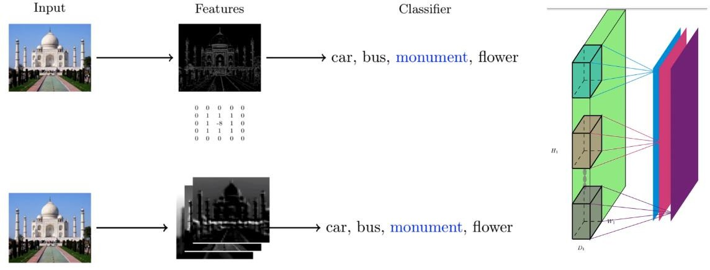
Convolutional Neural Networks
Why not the let the network learn multiple features
Features are not handcrafted- No explicit feature extraction.
Convolution applied directly on input image !!

Slide 24
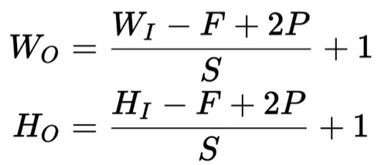
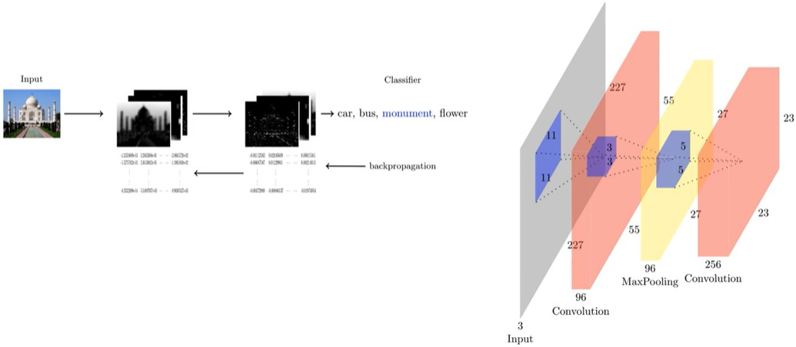
Convolutional Neural Networks
Why not the let the network learn multiple layers of feature representations
96 filters
227x227
55x55
Wi x Hi=227x227
F=11 (96 filters of 11x11) D=3 (Depth of input same as depth of filter)
S=4
(𝟐𝟐𝟕−𝟏𝟏+𝟎)
Wo=
+1= 55
𝟒
Ho=
(𝟐𝟐𝟕−𝟏𝟏+𝟎)
+1= 55
𝟒
Do = 96 ( there are 96 filters)
P=0
Depth of filter is always depth of the input
55x55x96 volume

Slide 25
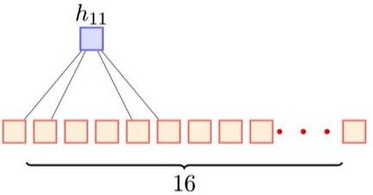
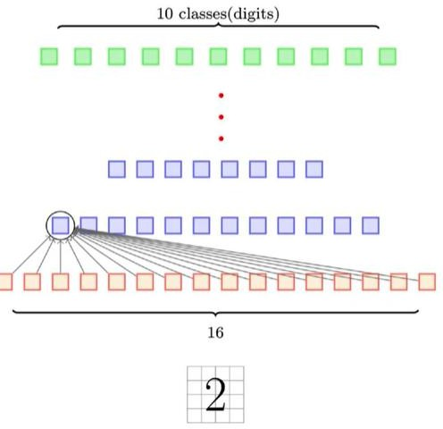
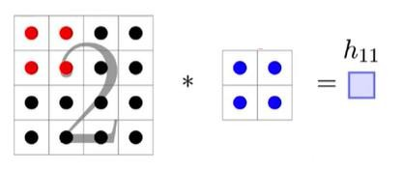
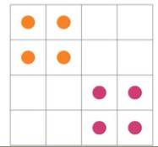
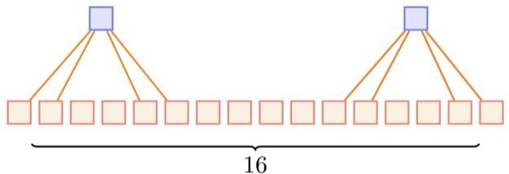
Sparse Connectivity and Weight sharing of CNN
CNN has Sparse connections
1 2 3 4 5 6
1 2 3 4
5 6 7 8
1 2
5 6 positions
CNN does weight sharing
As the kernel slides over input, the same weights are used to compute value at each hidden neuron
Fully connected- Deep NN

Slide 26
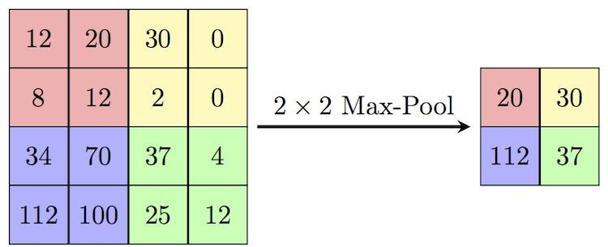
Pooling (Max Pooling)
Pooling layers are generally used to reduce the size of the inputs and hence speed up the computation. Consider a 4 X 4 matrix as shown below:
Max Pooling is a convolution process where the Kernel extracts the maximum value of the area it convolves.
Max-pooling helps in extracting low-level features like edges, points, etc.
Average Pooling is another pooling operation that calculates the average value for patches of a feature map, and uses it to create a downsampled (pooled) feature map. It is used after a convolutional layer.- Avg-pooling goes for smooth features.

Slide 27
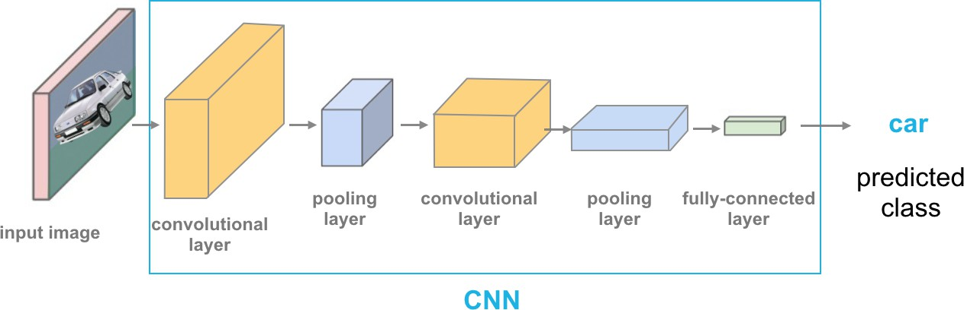
Convolutional Neural Network
In a convolutional network (ConvNet), there are basically three types of layers:
Convolution layer
After each convolution there is non-linearity applied using
activation functions- Relu/Leaky Relu. H1=g(a1)
Pooling layer
Fully connected layer
.

Slide 28
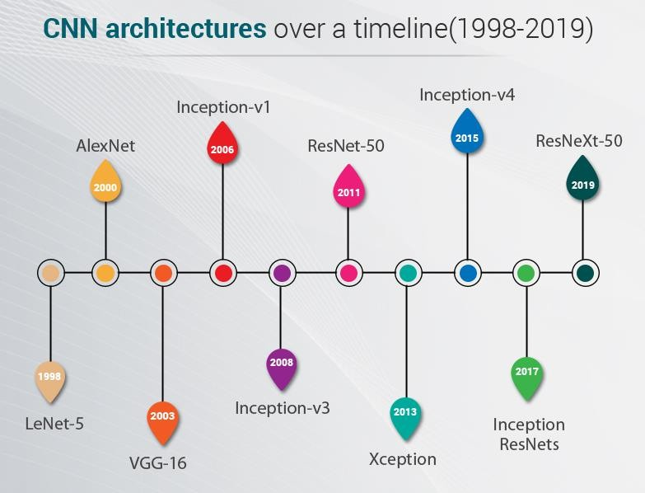
Different CNN Architectures
No: of Layers :How many
convolutional, max pooling fully
connected layers?
No: of Filters in each layer
Filter Size
Max pooling: What arrangement? 2
convolutional and then maxpooling
or alternate convolutional and
maxpooling?
Use standard tried and tested architectures!

Slide 29
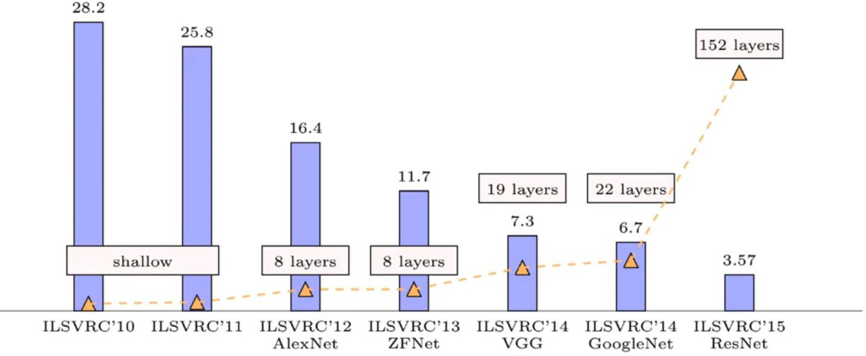
ImageNet Large Scale Visual Recognition Challenge (ILSVRC)
Error rate
https://image-net.org/challenges/LSVRC/index.php

Slide 30

LeNet-5 – First CNN Architecture
Earliest pre-trained models proposed by Yann LeCun and others in the year 1998, in the research paper Gradient-Based Learning Applied to Document Recognition. They used this architecture for recognizing the handwritten and machine-printed characters.
6x5x5=150
Depth of filter is always depth of the input
5x5x6x16=2400
After each convolution there is non-linearity applied using activation functions- Relu/Leaky Relu. h1=g(a1)

Slide 31


LeNet-5 – First CNN Architecture
Calculation of no of parameters
FC1
Conv Layer 2
Conv Layer 1
Flatten 5x5x16=400 neurons Hidden layer size=120
Bias from each node comes to 120
Parameters = 400x120+120=48120
FC2
Hidden layer 1 size= 120 Hidden layer2 size =84
Bias from each of 84 hidden layer neuron=84
No of parameters=
120x84+84=10164
FC3
Hidden layer 1 size= 84 Hidden layer2 size =10
Bias from each of 10 hidden layer neuron=10 No of parameters= 84x10=850 +10
S=1,F=5,K=6 W0=(32+0-5)/1+1=28,
As no of filters 6 we get 6 outputs
of 28x28 ( Filter size 5x5)
No: of parameters= 5x5x6=150
S=1,F=5,K=16 W0=(14+0-5)/1+1=10,
As no of filters 16 we get 16 outputs of 10x10 from 6 input images( Filter size 5x5)
[Comparing with fully connected Flatten 32x32
Flatten 28x28x6 Total parameters = 32x32x28x28x6]
No: of parameters= 5x5x6x16=2400
[Comparing with fully connected
14x14x6x10x10x16]

Slide 32



How to train a Convolutional Neural Network
Deep learning frameworks have optimized codes which does not have to do the zero weight calculations or storage

Slide 33

ALexNet (8 layers)
AlexNet is the name of a convolutional neural network (CNN) architecture, designed by Alex Krizhevsky in collaboration with Ilya Sutskever and Geoffrey Hinton, who was Krizhevsky's Ph.D. advisor in the year2000
3.55 M
4M
16M
4M
Layer5
Layer4
Layer3
Layer8
Layer2
Layer7
Layer6
Layer1
Depth of filter is always depth of the input

Slide 34












ALexNet (8 layers)

